Slide 1
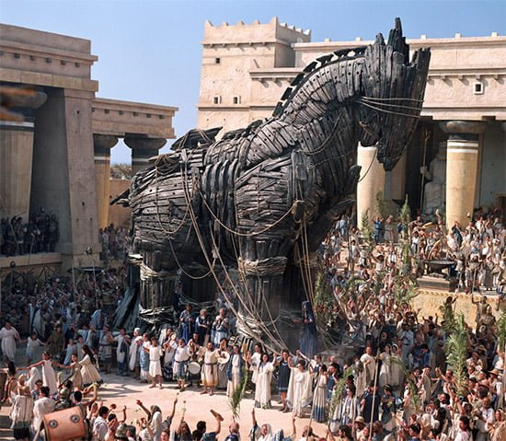
Task 2 Overview
Goal/s:
Discuss task 2 – explanation (trojan war)
Get out your book/folder –
you do NOT need to rule up/title/goals
Week 6 Lesson 1
Ms Barrie

Slide 2
Project Overview
Task Booklet

Slide 3
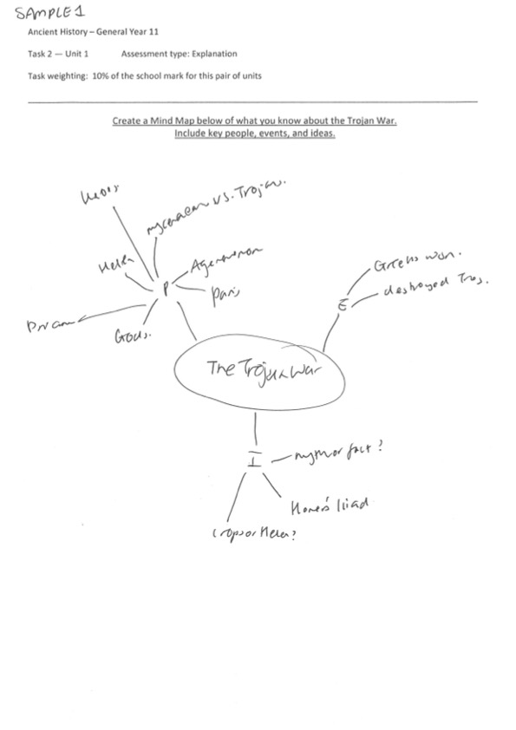
Sample 1

Slide 4
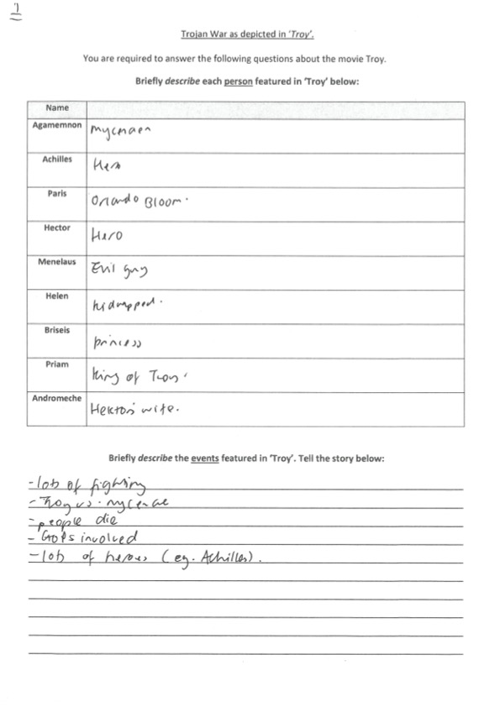
Sample 1

Slide 5
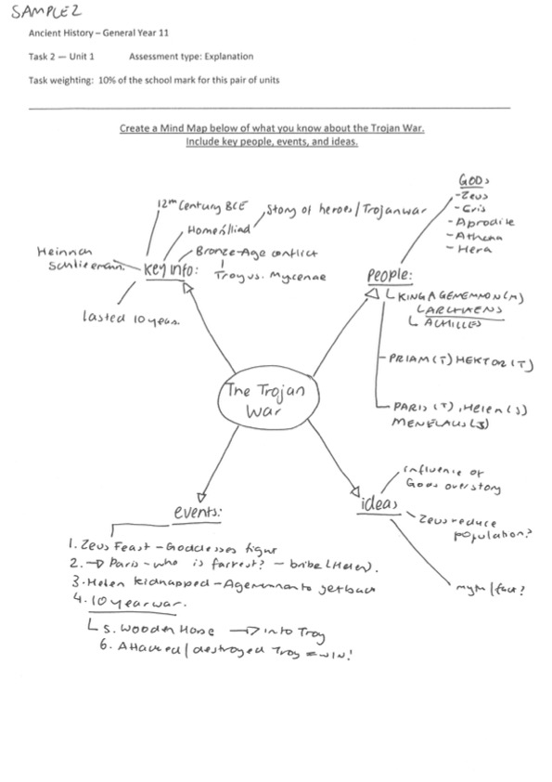
Sample 2

Slide 6
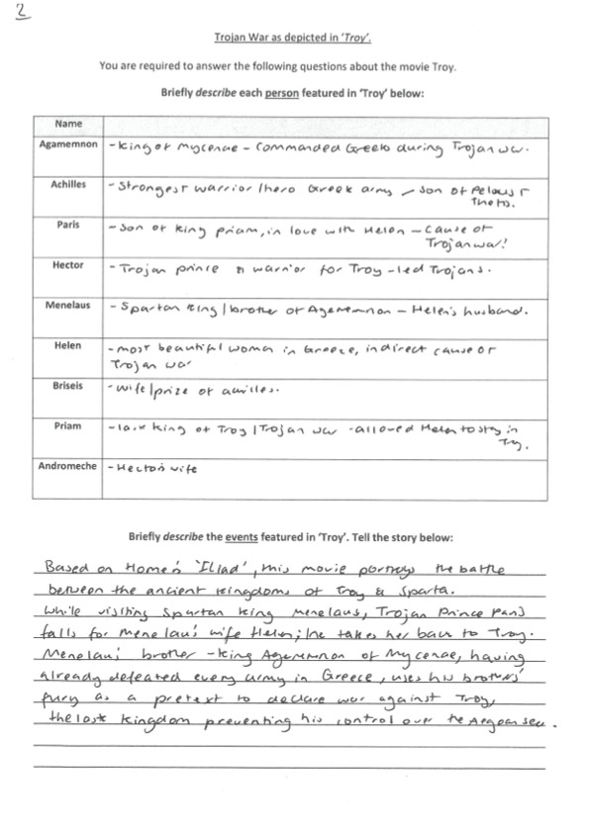
Sample 2

Slide 7
Project Timeline
 | Tuesday | Wednesday | Thursday | Friday
Week 6 | Intro to Task 2 Mindmap – Trojan War Homer’s Illiad | TROY MOVIE Troy Movie Booklet | TROY MOVIE Troy Movie Booklet | TROY MOVIE Troy Movie Booklet
Week 7 | Essay Lesson 1 Introductions and Conclusions | Essay Lesson 2 Body Paragraphs | PREP LESSON | IN-CLASS ESSAY/ EVERYTHING DUE

Slide 8
What to do and what NOT to do
Use-dot points and simple information
Complete all components of the task
Think carefully
Use the resources provided to you
ASK FOR HELP IF YOU NEED IT
Not attempt/Leave the page half-blank
Copy someone else’s work
Waste time
Not catch up on work if away
‘I can’t do this’ mindset

Slide 9
Today’s Lesson
Complete the following booklet pages:
Create a Mind Map below of what you know about the Trojan War. Include key people, events, and ideas.
Trojan War as depicted in Homer’s ‘Iliad’

